Slide 1
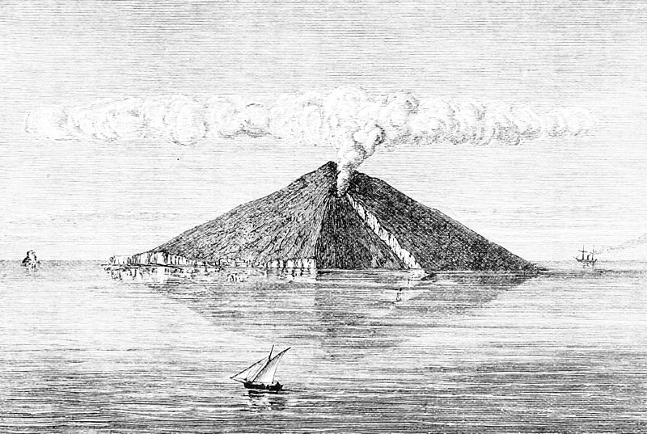
Muography with nuclear emulsions in Italy
Valeri Tioukov¹, Giovanni De Lellis¹, Andrey Aleksandrov¹, Lucia Consiglio¹, Andrey Sheshukov¹, Tatiana Shchedrina¹, Massimo Orazi², Rosario Peluso², Cristiano Bozza³, Chiara De Sio³, Simona Maria Stellacci³, ChiaraSirignano⁴, Nicola D’Ambrosio⁵, Seigo Miyamoto⁶, Ryuichi Nishiyama⁶, Hiroyuki Tanaka⁶, Mikhailo Vladimirov⁷
¹University of Napoli / INFN, Italy, ²INGV - Napoli, Italy, ³University of Salerno / INFN, Italy, ⁴Universityof Padova / INFN, Italy, ⁵INFN - LNGS, Italy, 6University of Tokio, Japan, , ⁷LPI - Moscow

Slide 2
Outlook
Nuclear emulsion laboratories and experiments in Italy
Recent Muon radiography projects with Italian emulsion laboratories involved
Stromboli exposure 22-Oct-2011 - 24-Mar-2012 for 154 days
Potential and prospective of muography with nuclear emulsion in Italy

Slide 3
Emulsion projects and laboratories in Italy
Main business is fundamental Particle Physics (neutrino experiments in particular)
1990 – 2002 CHORUS experiment
2002 – now OPERA project
Emulsion scanning laboratories in Italy (OPERA participants)
  Napoli, Salerno, Gran Sasso, Bari, Bologna, Padova
  About 30 scanning systems were constructed in Italy for OPERA scnning
Since 2011 – some laboratories are involved in Muography projects
  Napoli, Salerno, Gran Sasso

Slide 4
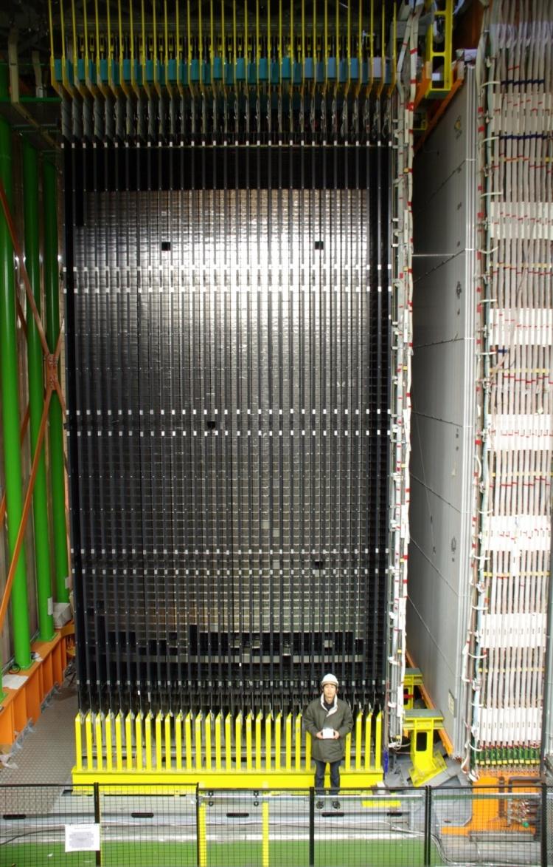
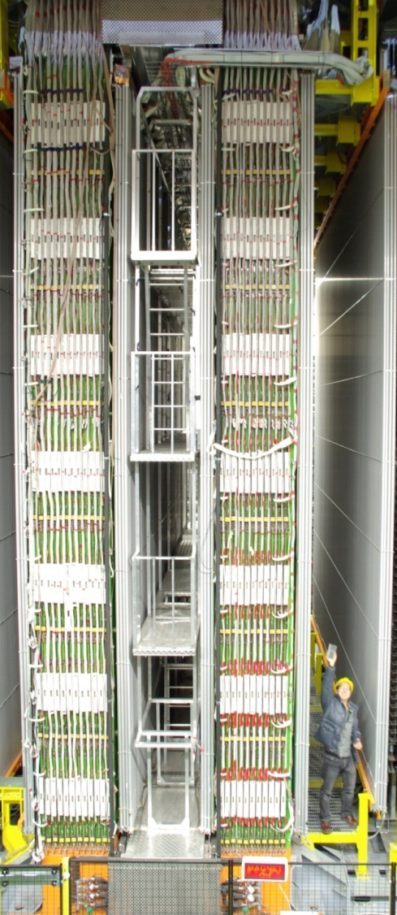
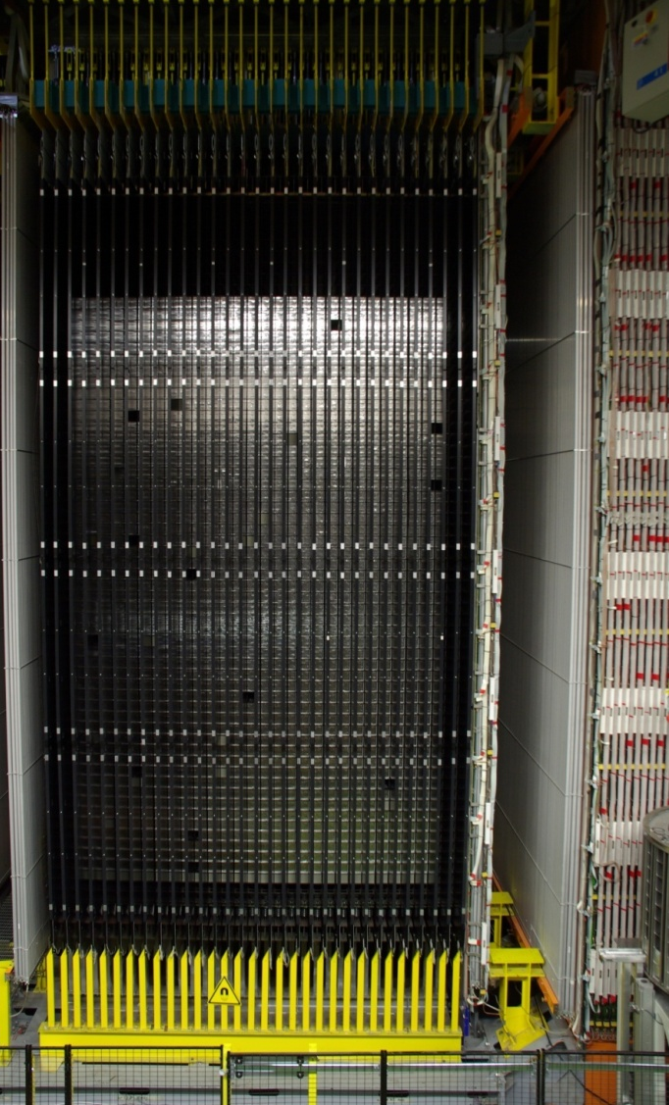
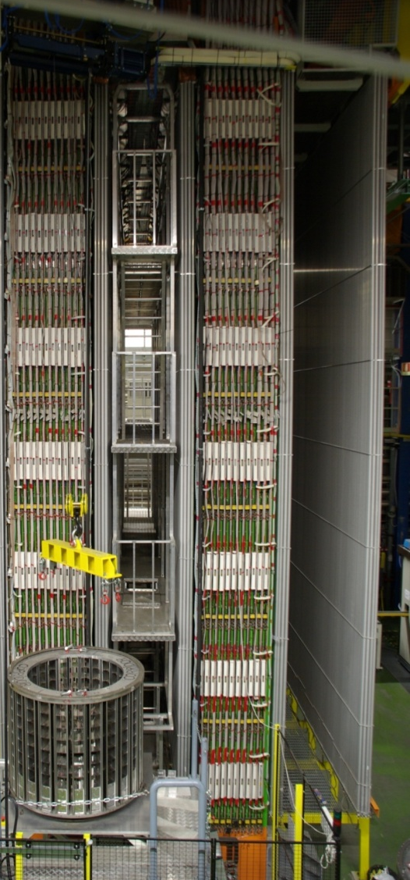
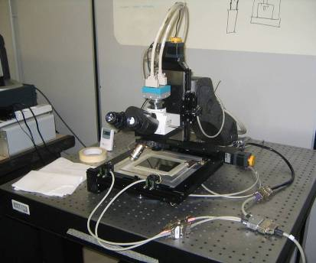
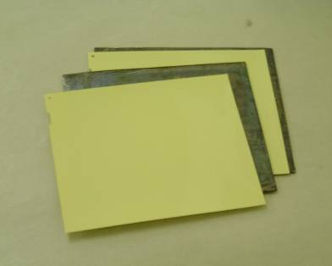
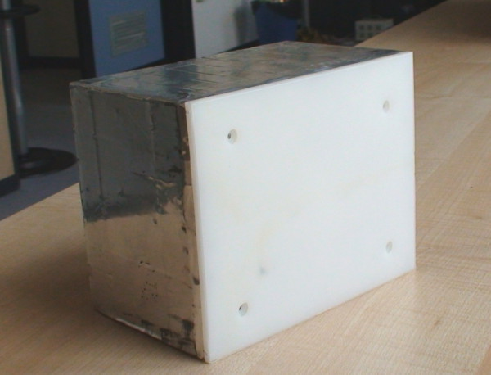
The OPERA detector: 8.9 mln films with the total emulsion sensitive surface of 200000 m²
neutrino
10x10x50 meters
apparatus
ECC “brick”
57 emulsion plates
56 lead plates
10x12x7 cm, 8 kg

Slide 5
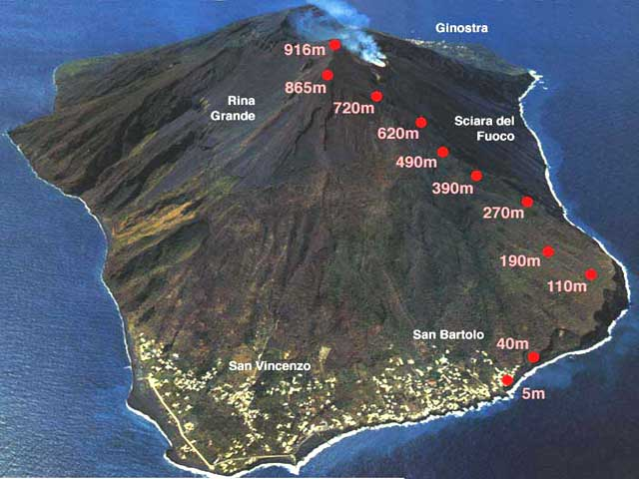
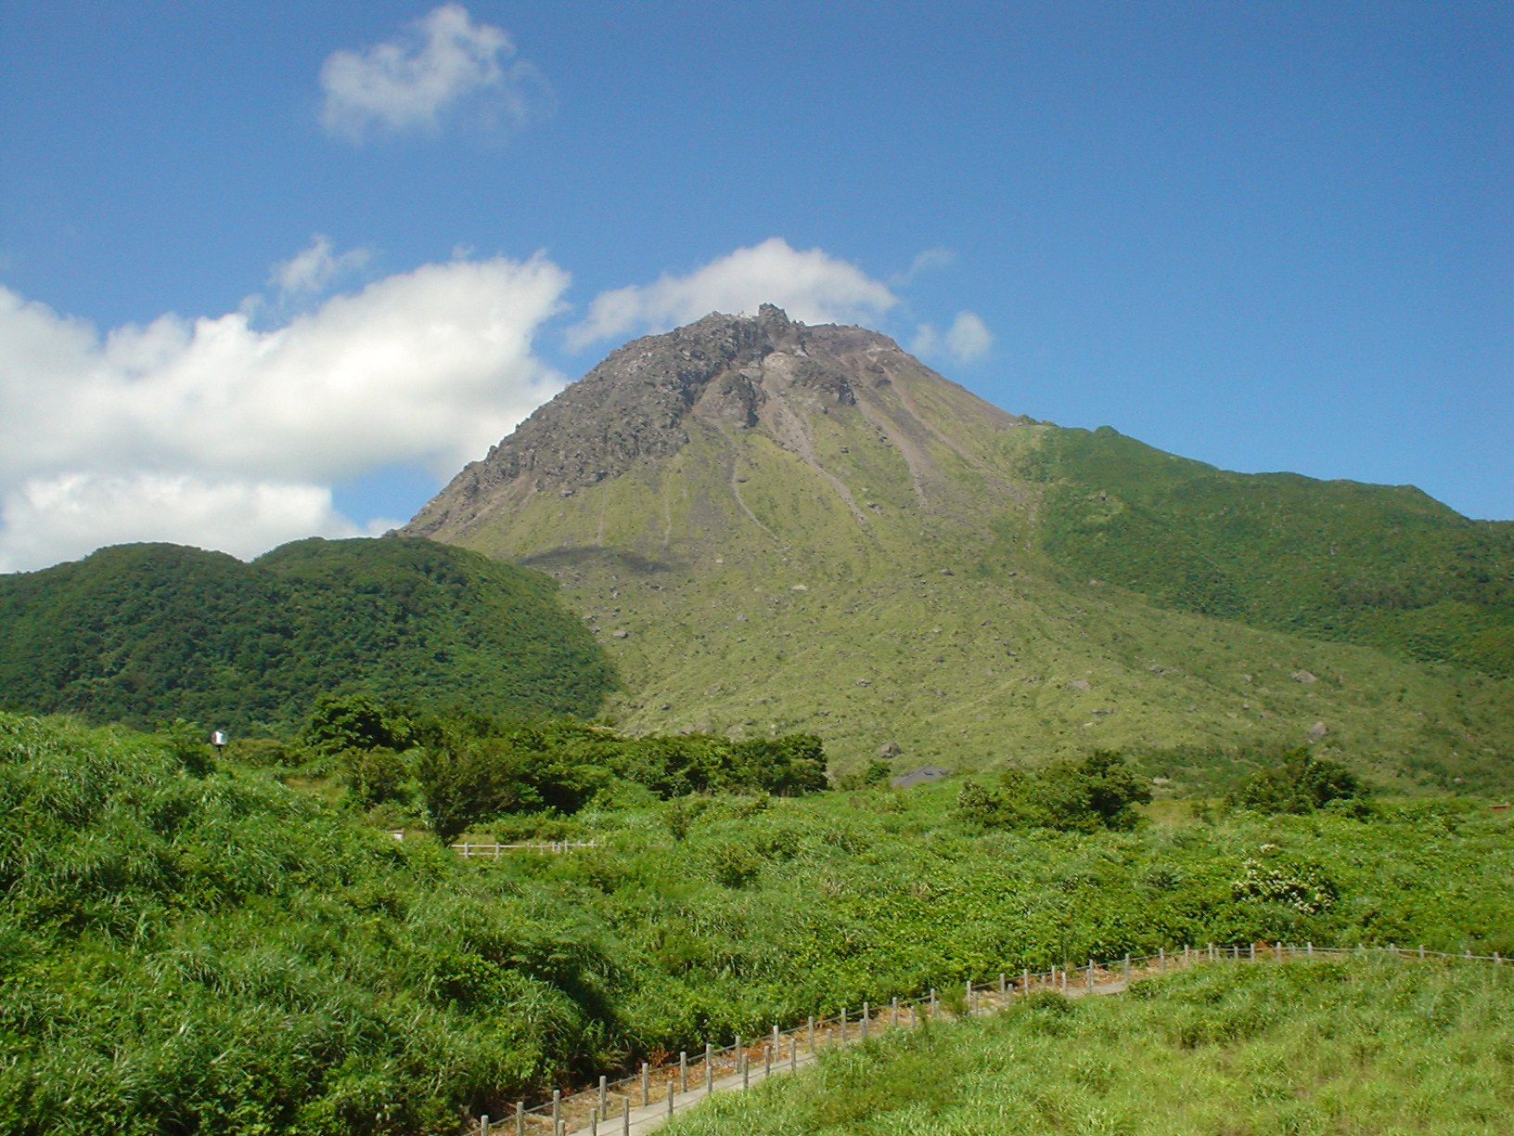
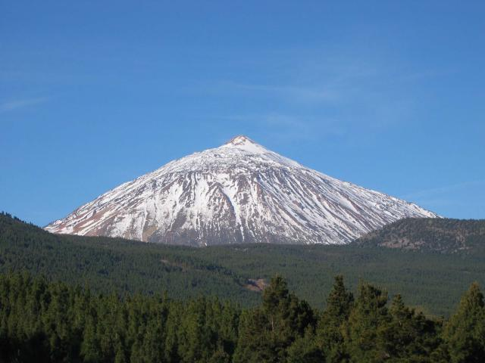
Stromboli
Muography emulsion projects with
participation of Italian laboratories
Unzen - data analysis is in the final phase
Stromboli – half statistics, first results
Teide – exposure is completed, scanning is started
Unzen
Teide summit

Slide 6
The principle of muon radiography
It’s assumed that the muon flux and spectrum well known and nearly constant
Assumed the precise knowledge about the mountain shape
What we can obtain is the angular map of the average rock density using the muons absorption information
Detector should provide precise angle for each particle passed through
Telescope
Nearly horizontal
atmospheric muons cross the mountain
The method is limited to the upper part of the mountain above the detector
Low muons rate do not allow to have short exposure – months is a typical time scale
1 km of the rock thickness is an approximate upper limit for 1-few m² detectors with few months exposure
Emulsion is a good candidate!
10/15/2013
Valeri Tioukov, IAVCEI 2013
6

Slide 7
Motivations for the Stromboli exposure
Stromboli is one of the most known and most active volcanoes in the world
Great amount of monitoring equipment is installed on the volcano slopes, but the exact internal structure of the region below craters is not well understood yet
There is a possibility that the explosion source mechanism is representative of two cracks dipping ∼60◦ that are located approximately 220-260 m, beneath the active craters, probably representing parts of an echelon system of fissures
muon radiography can be an independent technique for investigating the internal structure of the cone and revealing the location and extent of the conduits that feed the continuous explosions
Region under “Sciara del Fuoco” is the one of our interest
Motivations for muon radiography of active volcanoes,
G. Macedonio and M. Martini, Earth Planets Space, 61, 1–5, 2009

Slide 8
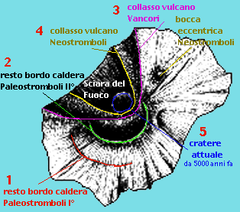
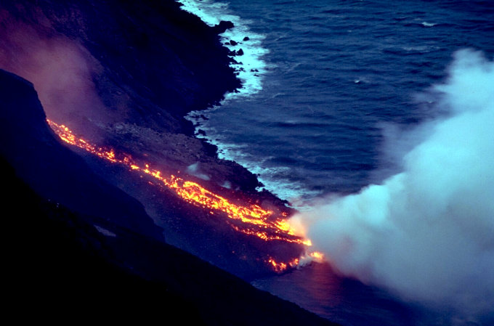
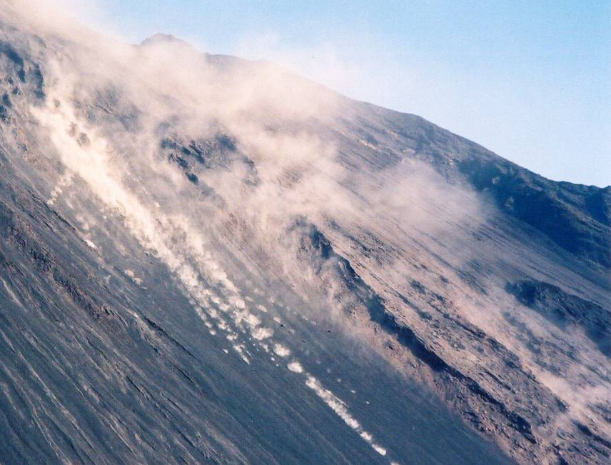

Slide 9
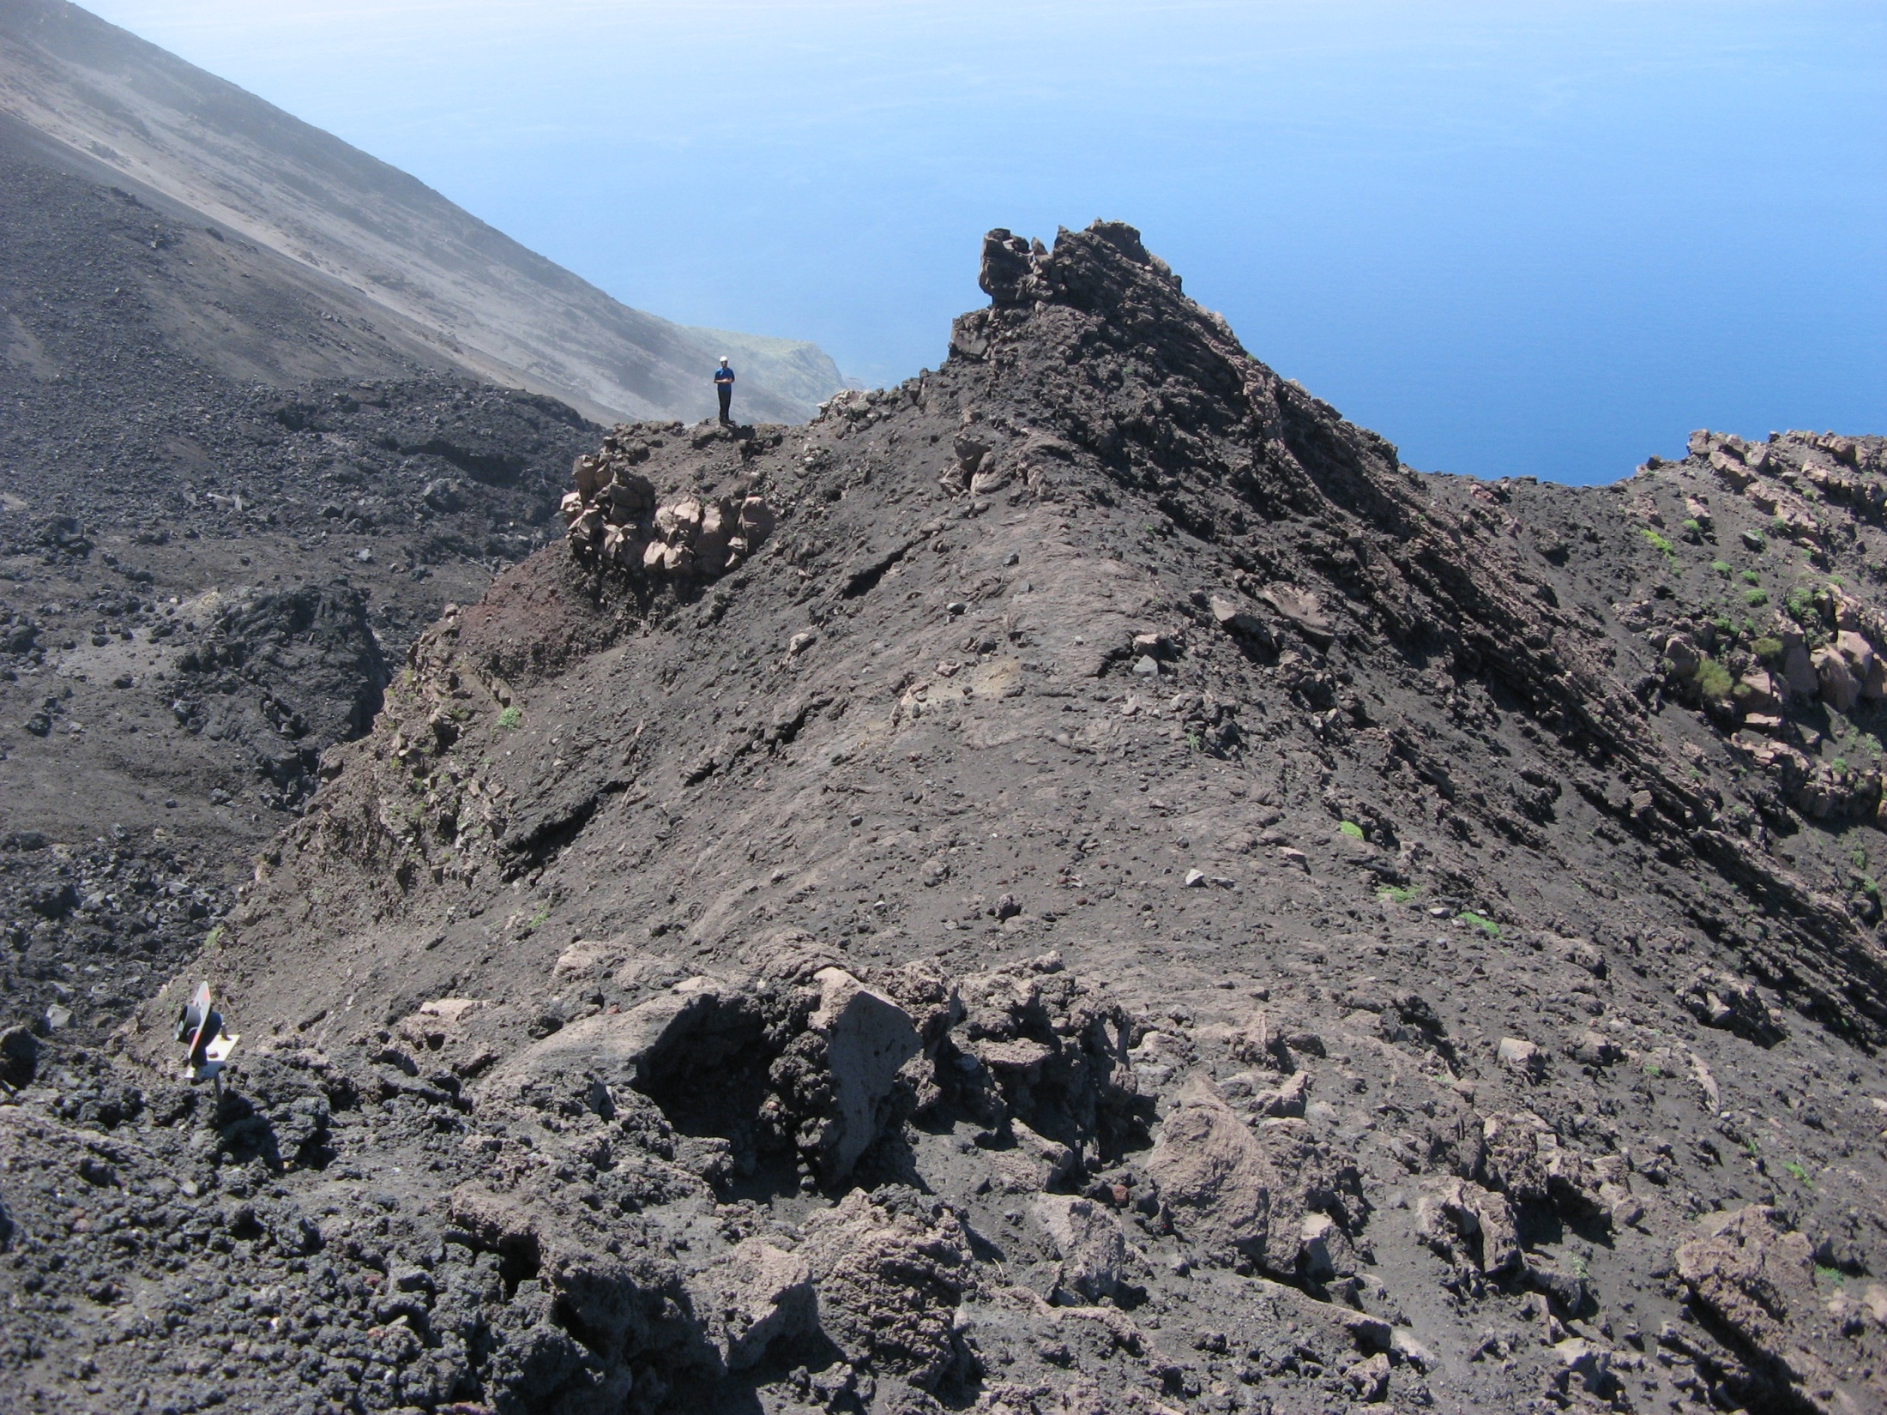
Good place for the detector installation was individuated in May 2011 (the only relatively flat at this altitude)

Slide 10
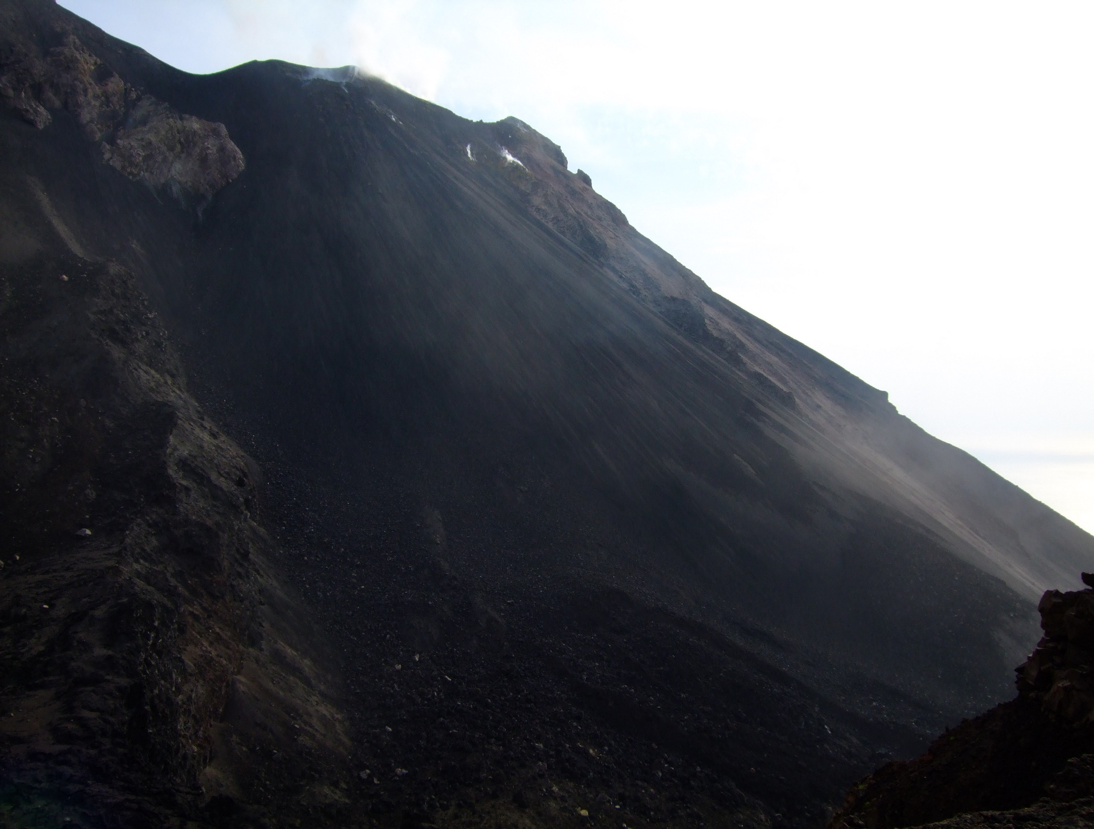
View from the detector position (640m)
Craters region (750 m)
Sciara del fuoco

Slide 11
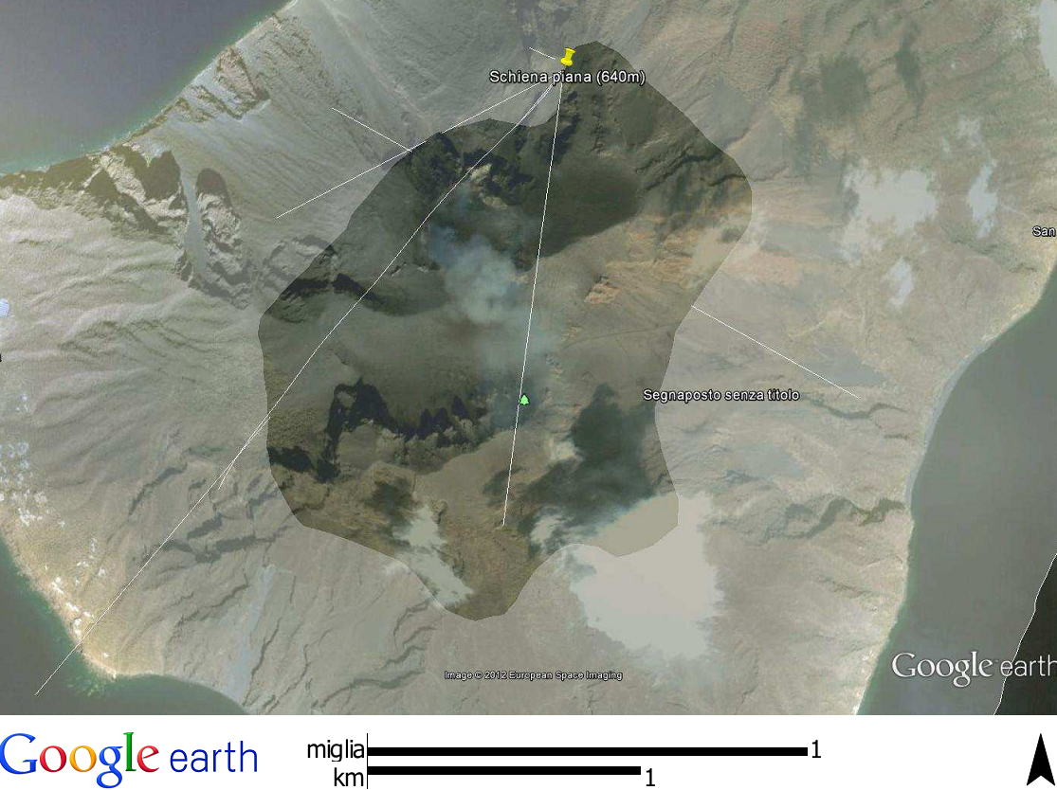
Above 500 m part of the island
Detector
Craters region

Slide 12
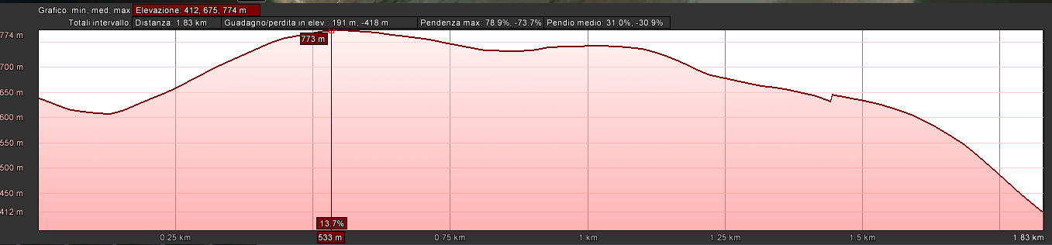
Example of the elevation profile
Tan =0.24
640 m
1.5 km
Stromboli has not so sharp cone - only a part of edifice can be
monitored with a middle-size muon telescope

Slide 13

Scheme of the internal module structure
One module with 10 emulsion “cells”
Each cell has 2 emulsions doublets attached
to both sides of the central metal plate.
Front view of the central plate (26 x 80 cm)
“Exploded view”
Aluminum Frame
Elastic (rubber) layers
The total weight of one module is of 26 kg
Total amount of emulsions/module: 40
The active surface covered is of 1200 cm2
The overall weight of 8 modules and the support frame is about 250 kg
Metal plates
of 5mm (inox)
Envelopes with emulsions
glued to the central
inox plate

Slide 14
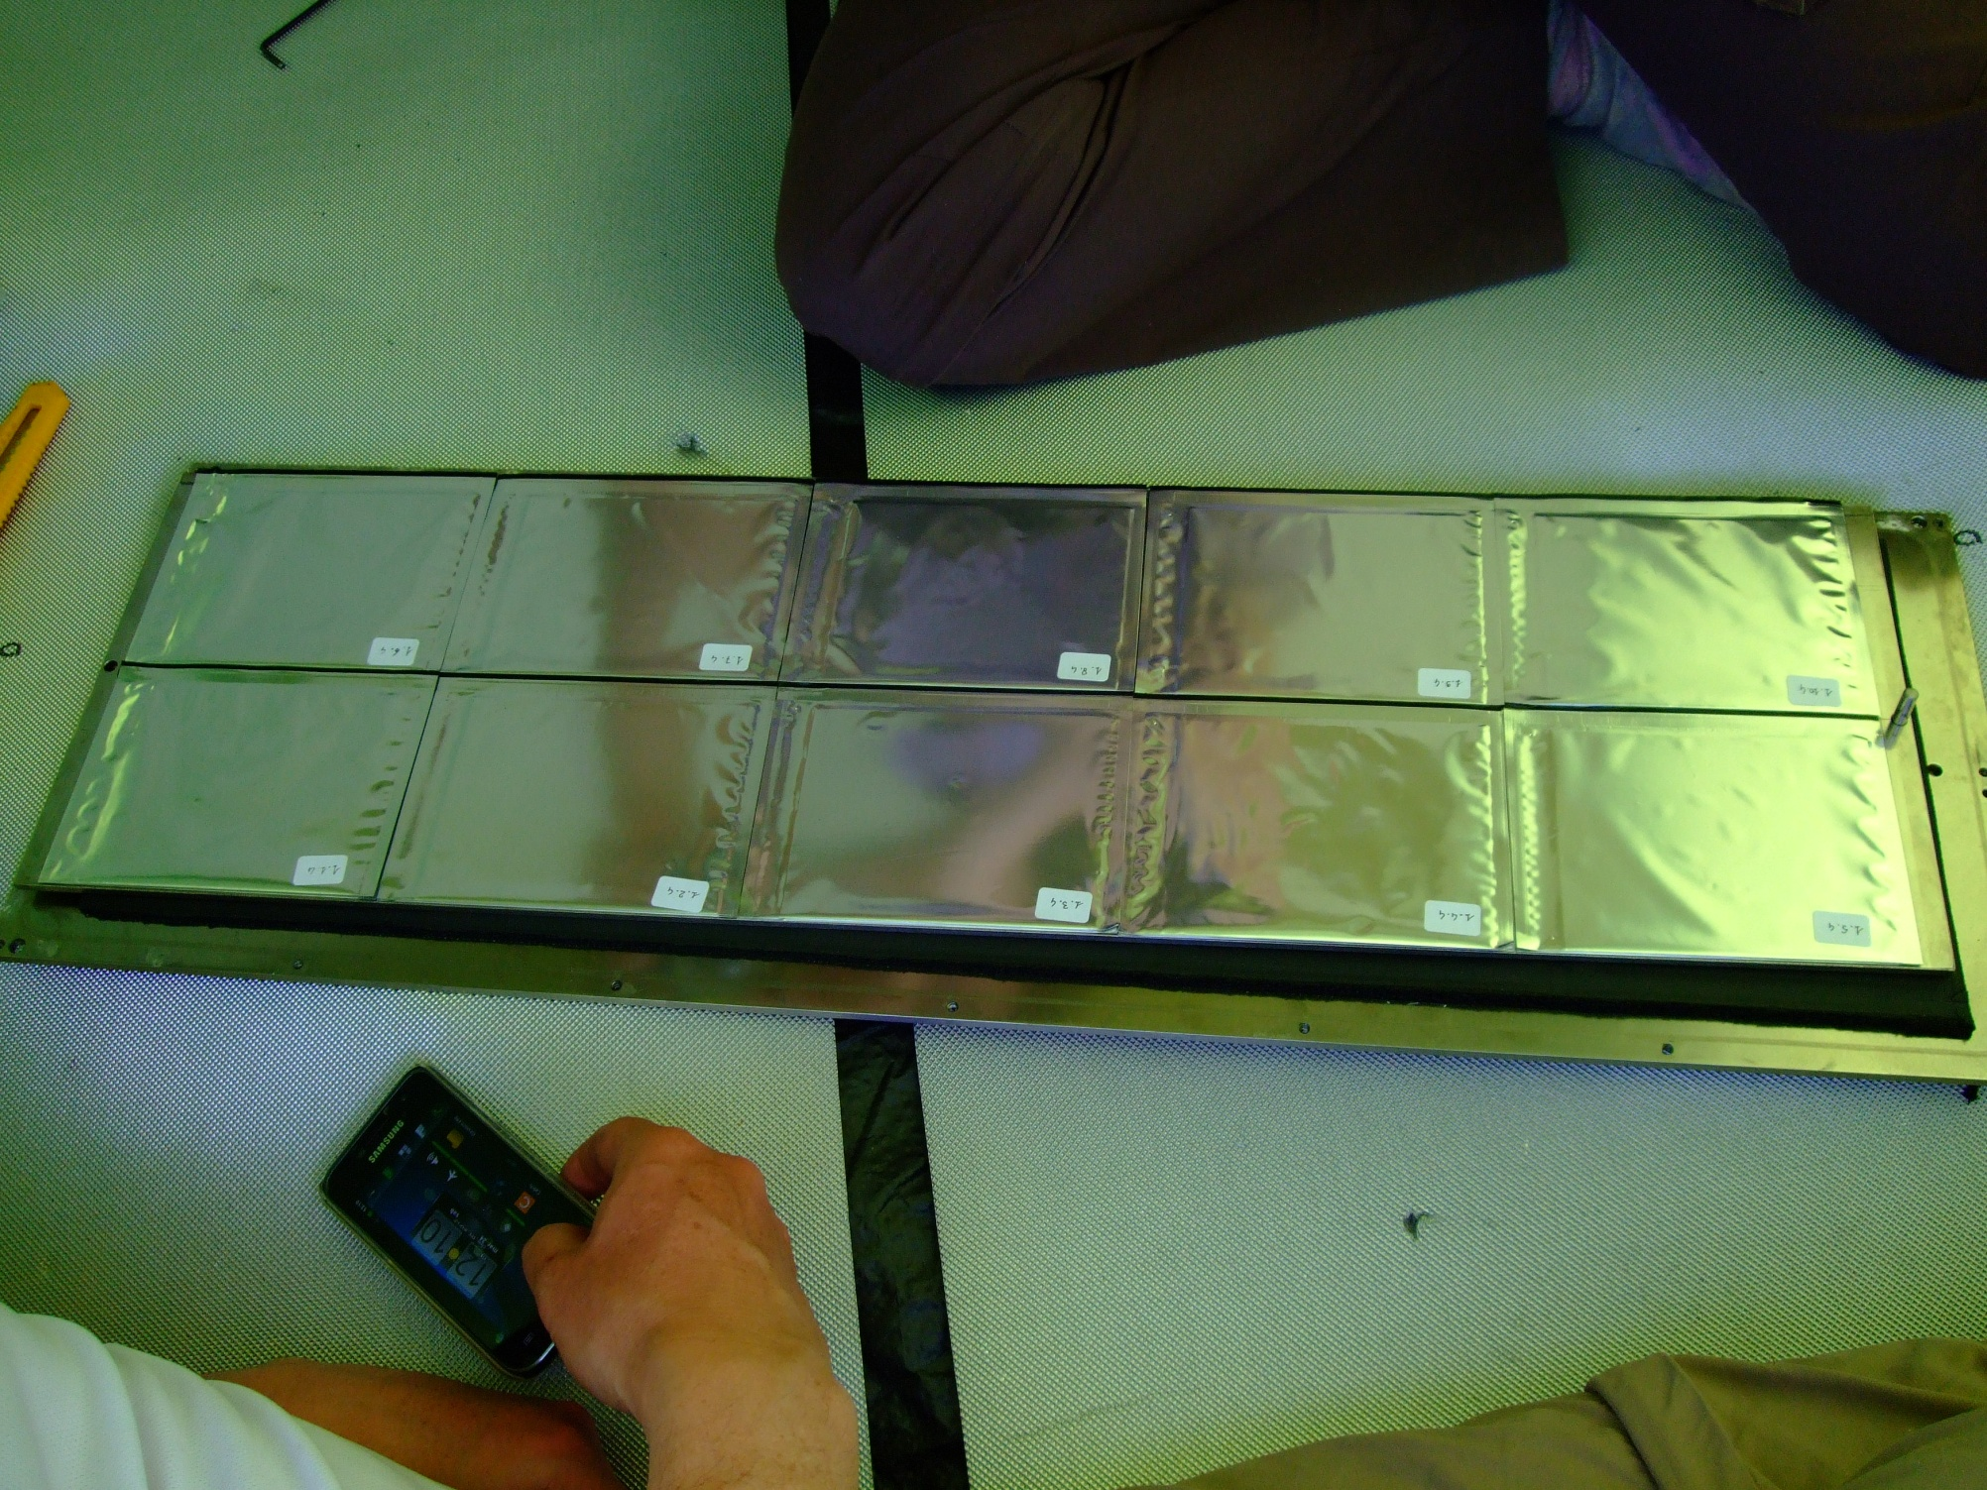
Emulsions extraction after 5 months exposure. The envelopes are in a good shape

Slide 15
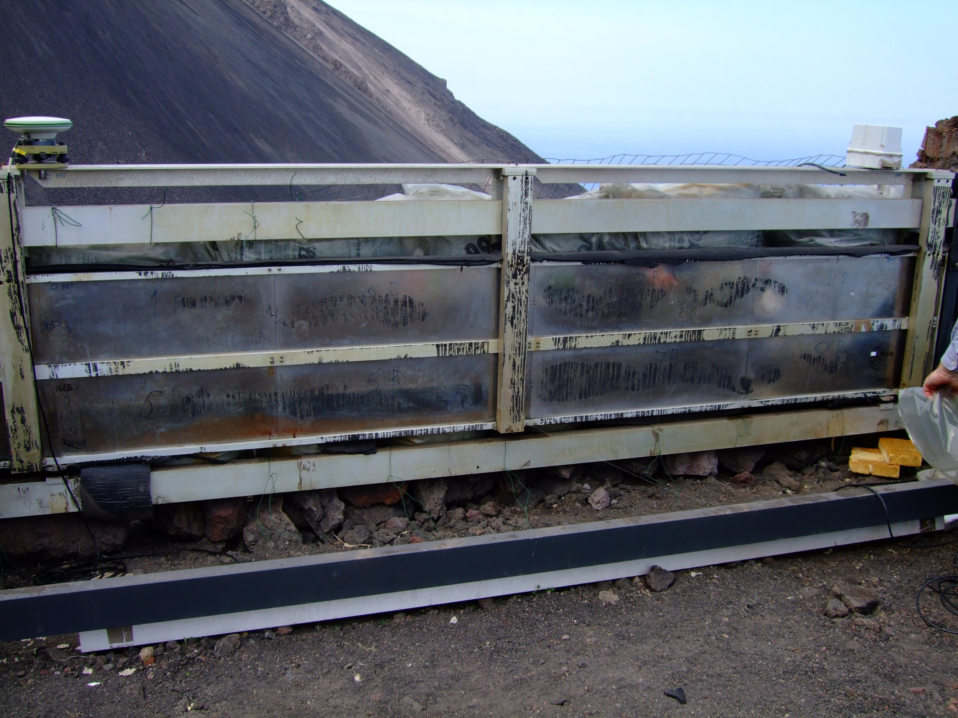
GPS
Movement sensor
3B
4B
1B
2B
8B
6B
7B
5B
The overall dimension is about 70 x 350 cm, 250 kg

Slide 16
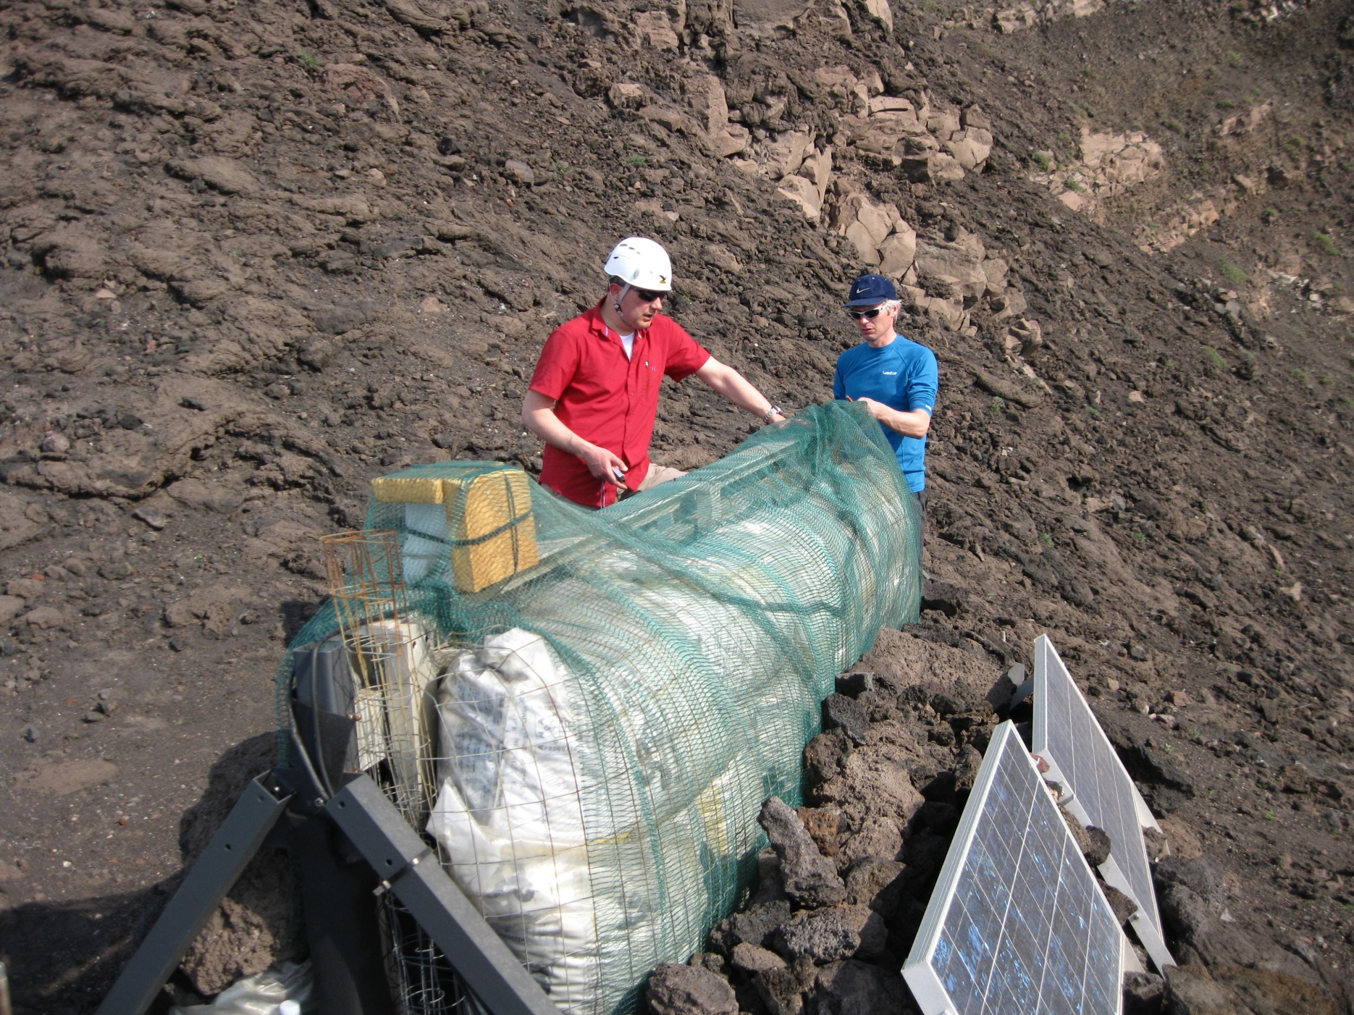
After 5 months of data taking we found the detector in a good shape well protected from sun heating and from moisture by rubber foam (armaflex) and by expanded clay

Slide 17
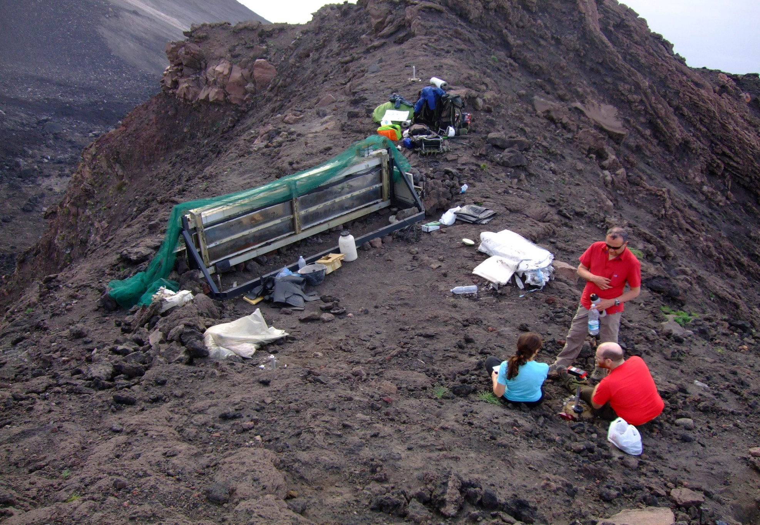
To keep memory about the module orientation 3 fixed vertices were installed and the distances measured with the laser distanziometer (+-2 mm accuracy)
GPS data were recorded on 2 detector and on 2 vertex points
1
3
2

Slide 18
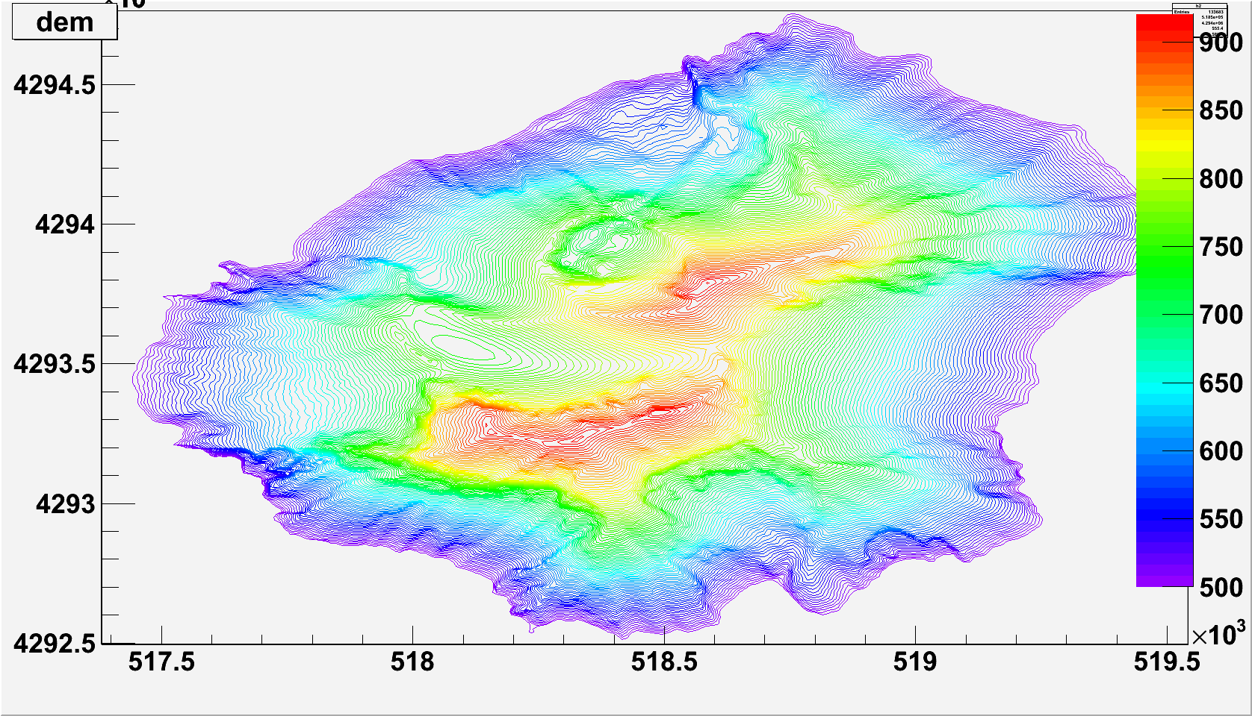
The data analysis assume the precise knowledge about the mountain shape
Detector position
Precise and up to date
Digital Elevations Map (DEM) Is required
Area of interest
Only the part of the island above
500m is displayed here

Slide 19
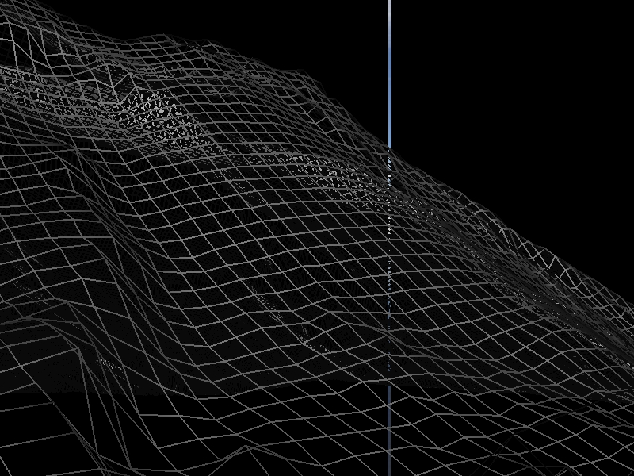
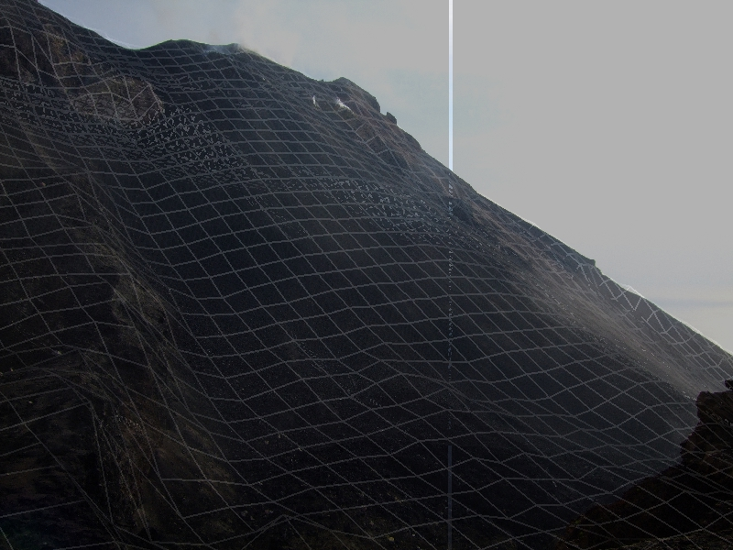
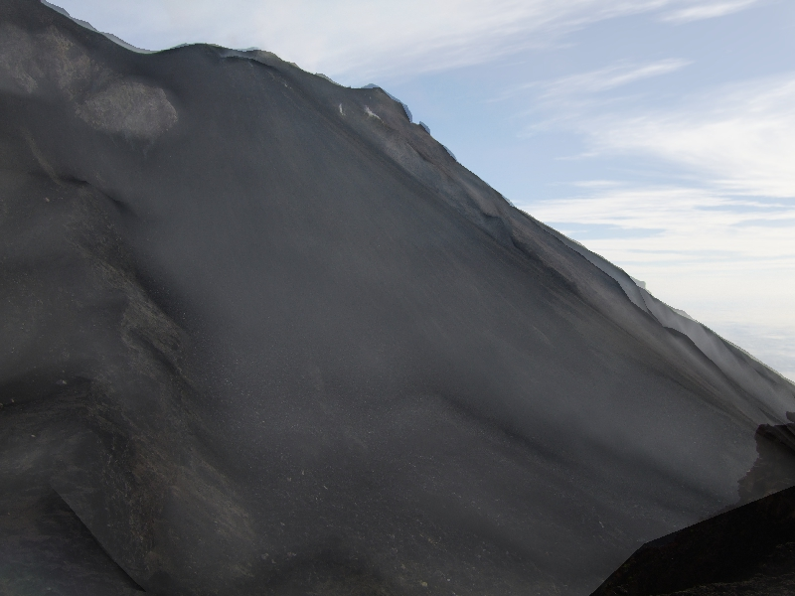
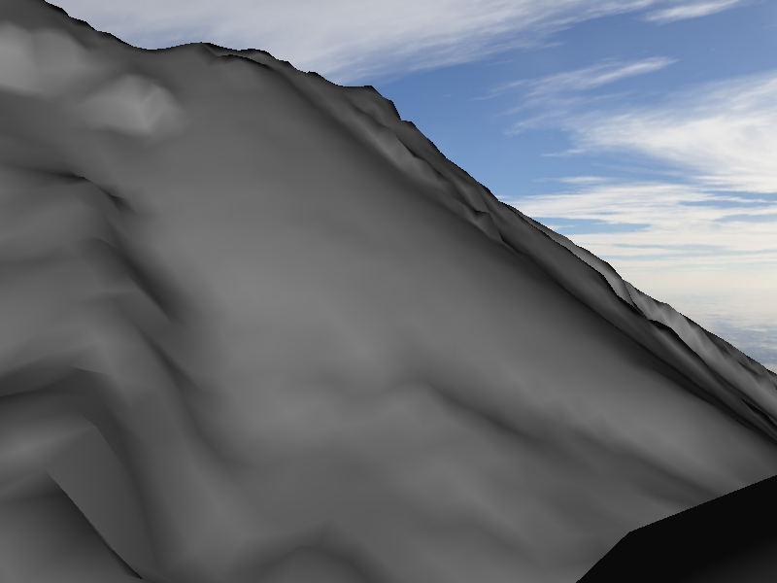
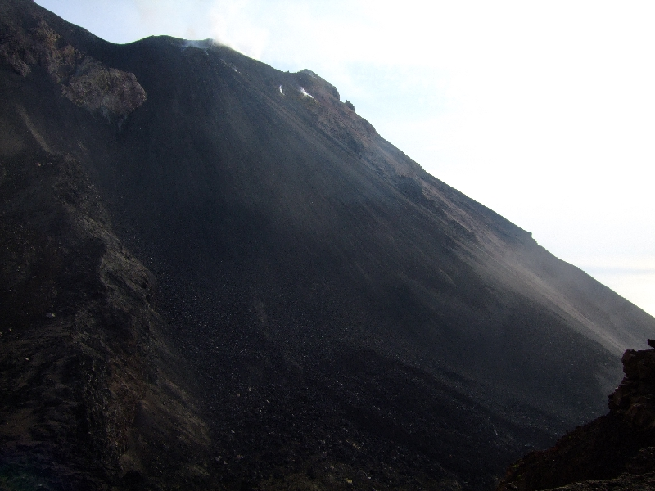
DEM – Photo comparison
Photographs of the mountain taken from the detector position compared to the shape of the DEM viewed from the same point
Precise images coincidence confirms the precision of the GPS coordinates

Slide 20
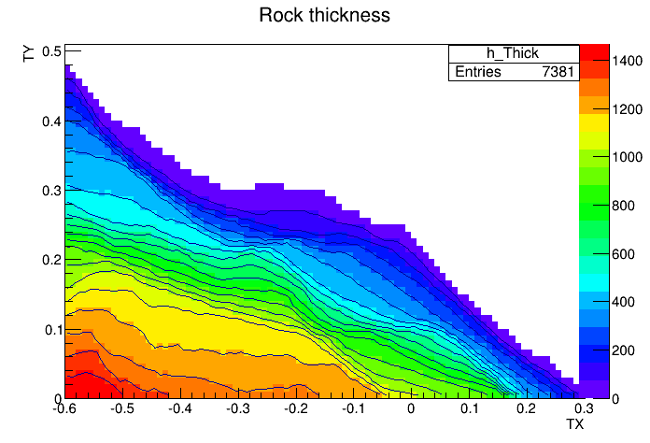

Slide 21
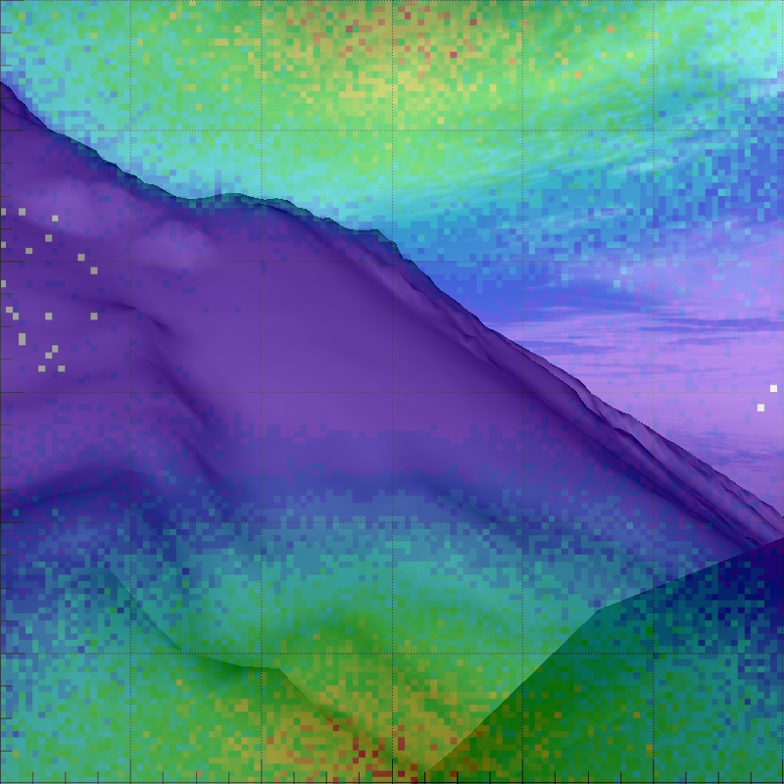
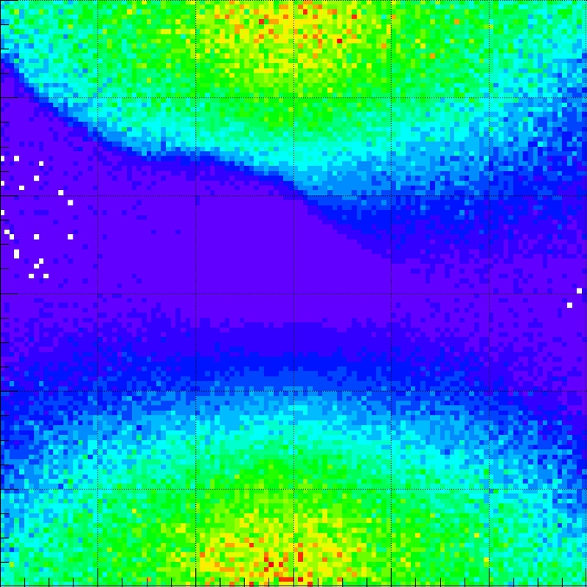
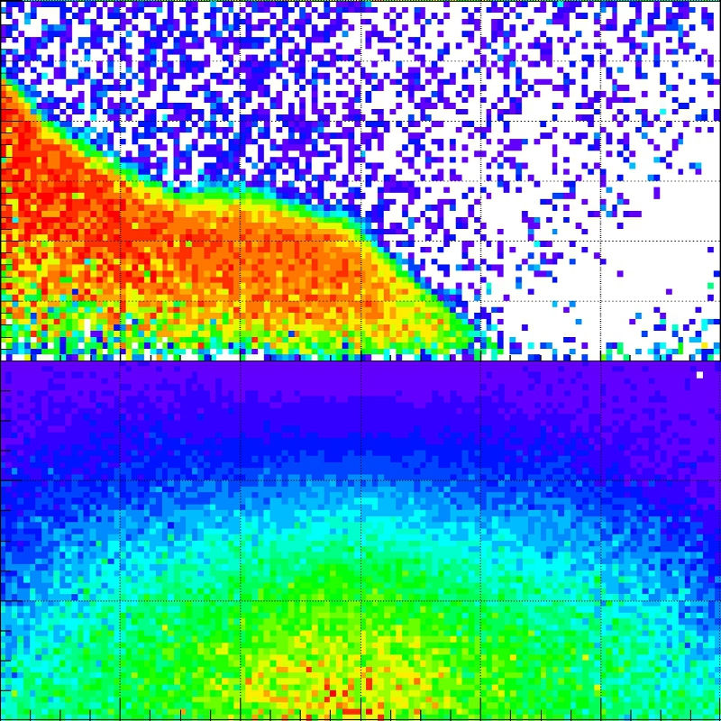
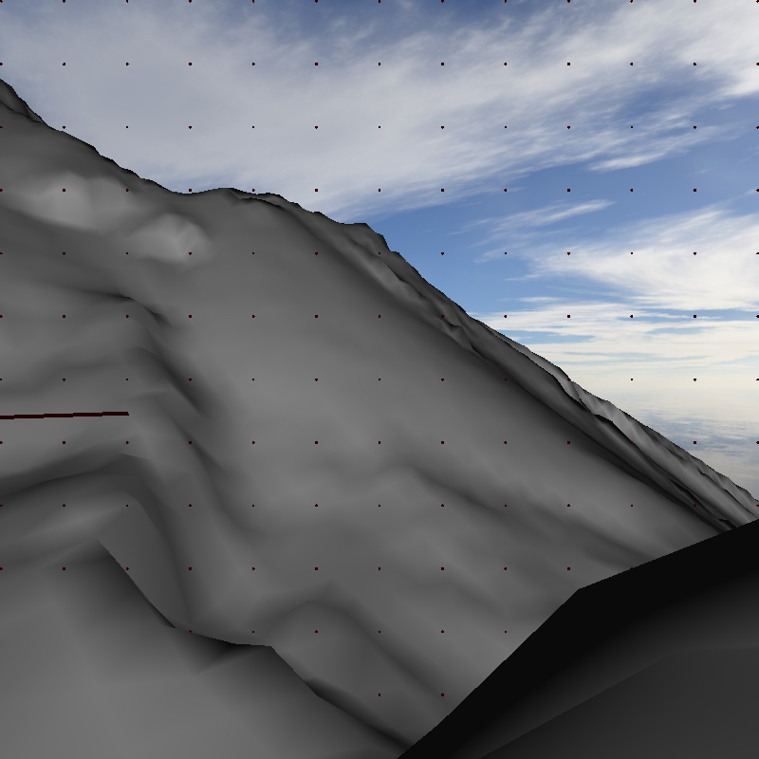
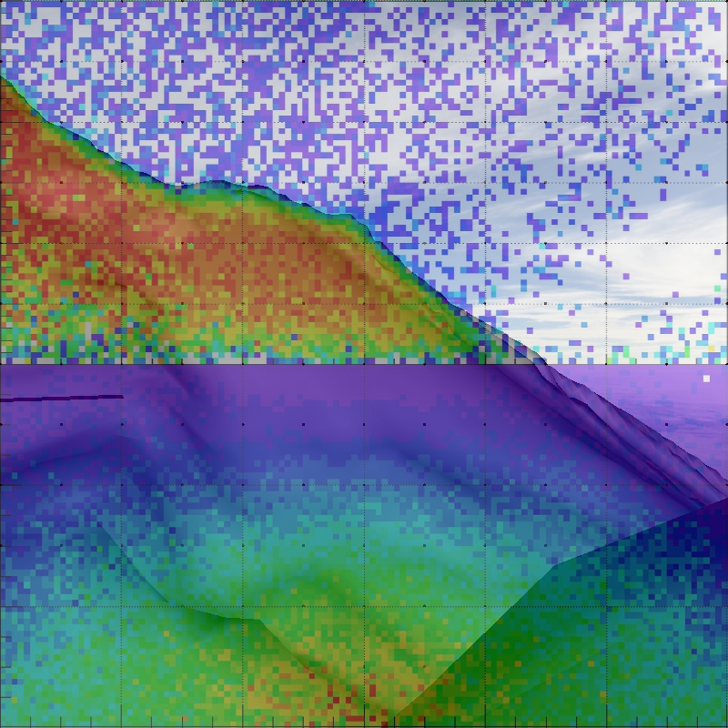
DEM – Data comparison
Dem view
Data tx-ty distribution
Dem-data superimposed
Data absorbed part
em-data absorbed superimposed

Slide 22
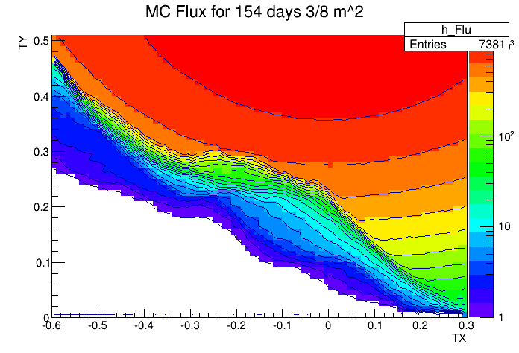
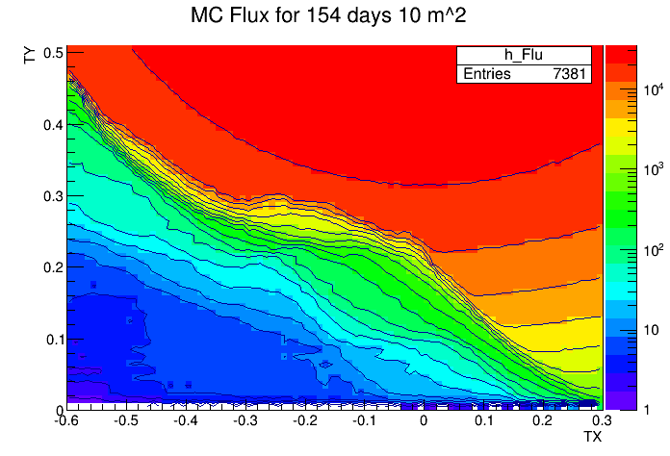
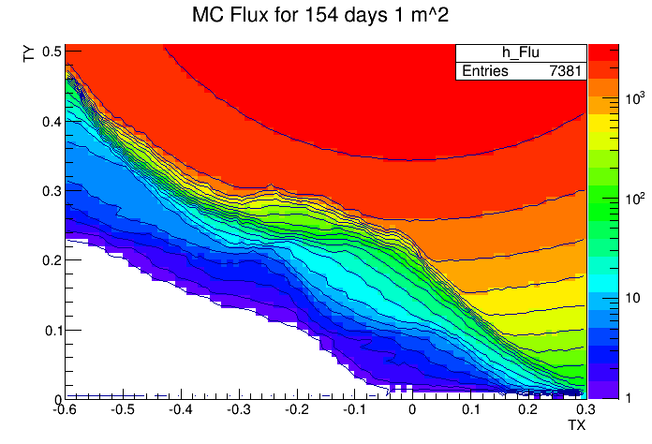
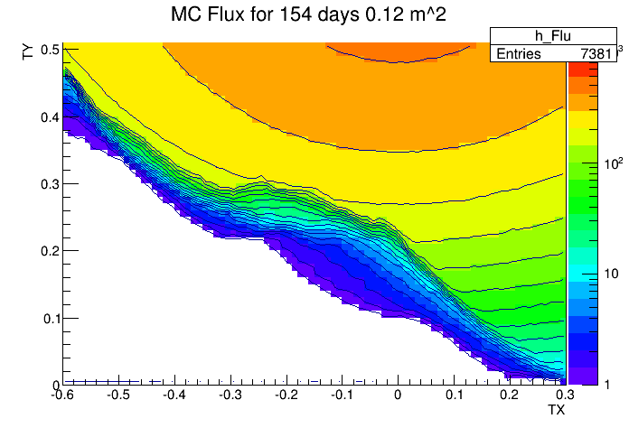
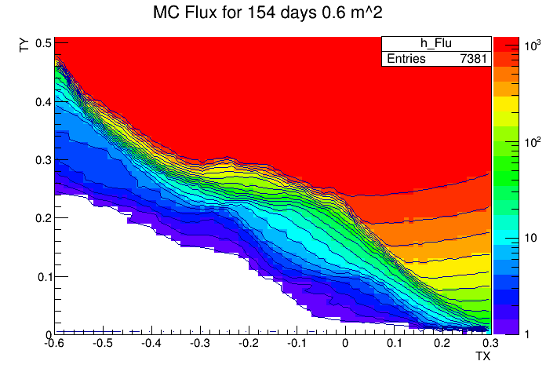
10/15/2013
Valeri Tioukov, IAVCEI 2013
22

Slide 23
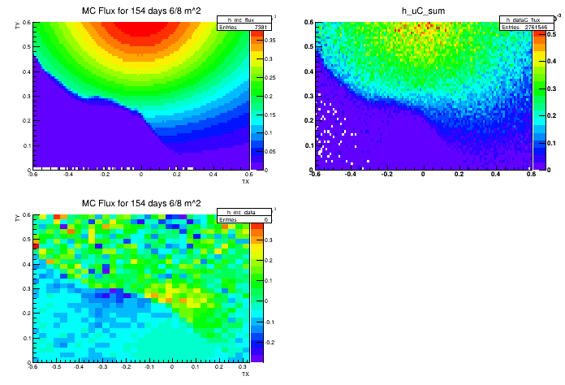
Data subtracted from MC
The first exercise of data-MC comparison on the incomplete statistics
We observe some data excess in a crater region in respect to MC, this can be a sign of lower density
It is difficult yet to judge about more fine effects
We plan to perform additional study to refine efficiency and background angular dependency corrections

Slide 24
Nuclear emulsions as a detector for muon radiography
Advantages
Perfect intrinsic angular resolution (better then 2 mrad)
Compact and easy to transport
No electricity required
Can be installed in a harsh environment
Modular, can be installed inside narrow locations
Disadvantages
No time information (can be solved in some cases)
Complicated and time-consuming data acquisition – required special scanning systems
accepted temperature range for long-term exposures is below 25 C
Single-use sensitive part
Able to provide new information complimentary to
other methods used for volcanoes survey

Slide 25
Prospective and potential for emulsion muography in Italy
Currently - a by-product of the technology developed for neutrino physics
The scanning power used in Italy for Unzen-Stromboli-Teide emulsions scanning is equivalent to 2 scanning systems used 30% of time
Resent scanning speed is about 20 cm²/h/layer so minimum time required for the full scanning of Stromboli-like detector (1m² x 8 layers) is of 170 days
In a near future (1-2 years) with OPERA load going down the available scanning power may become about 10-20 SS 100% available for muography - this means factor 30 speedup
Scanning systems HW upgrade is coming (see morning talk) with additional factor of 5 minimum increase of the scanning speed
In a short time scale we can acquire a potential to perform the analysis of 1 m² emulsion telescope in just a few days!
This makes emulsions an attractive option also for a large-scale muon telescopes, multy-points exposure (tomography) and for industrial applications

Slide 26
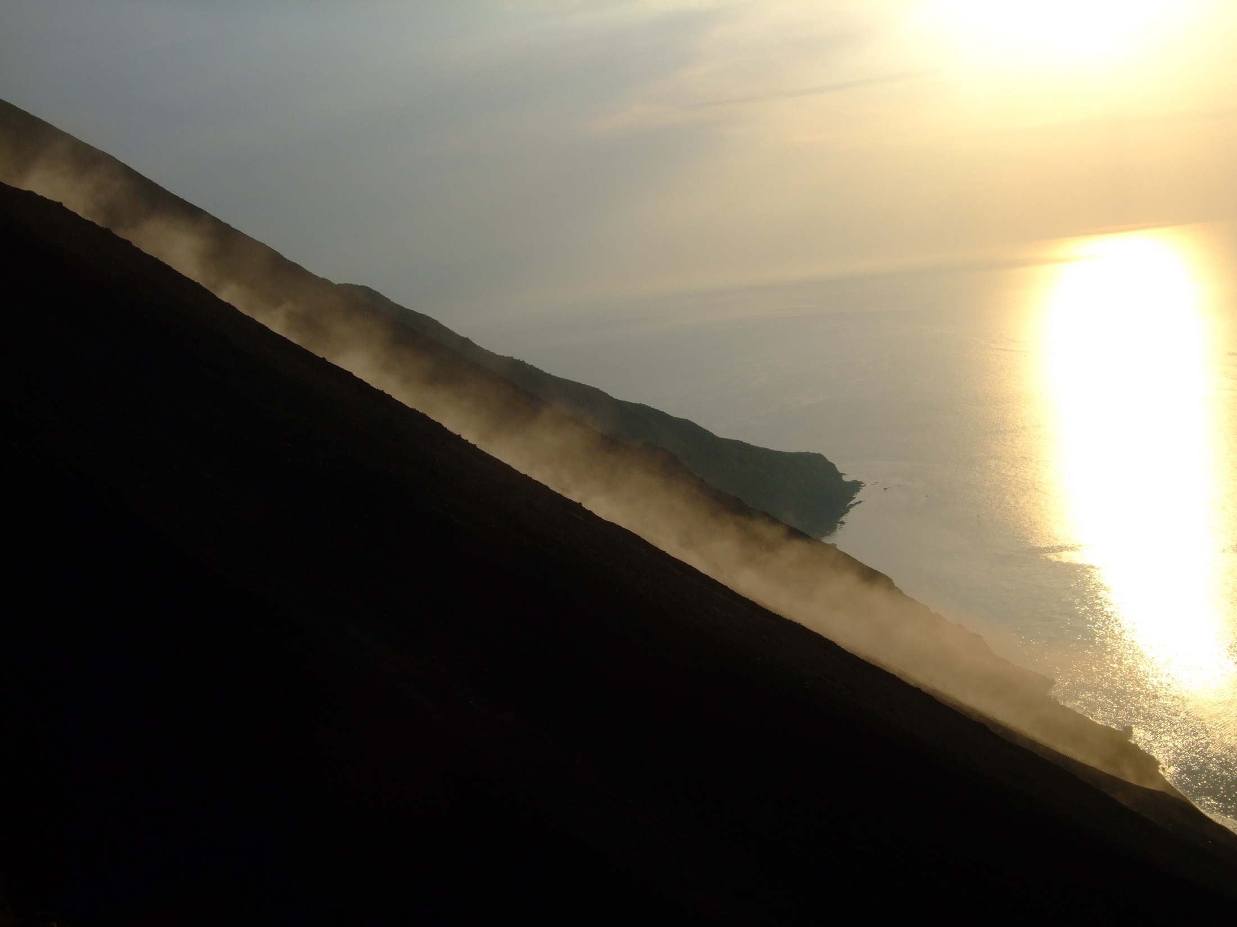
La Sciara del Fuoco al tramonto
Thank you for your attention!

